Slide 1
Analysis of Recursion
By Soham

Slide 2
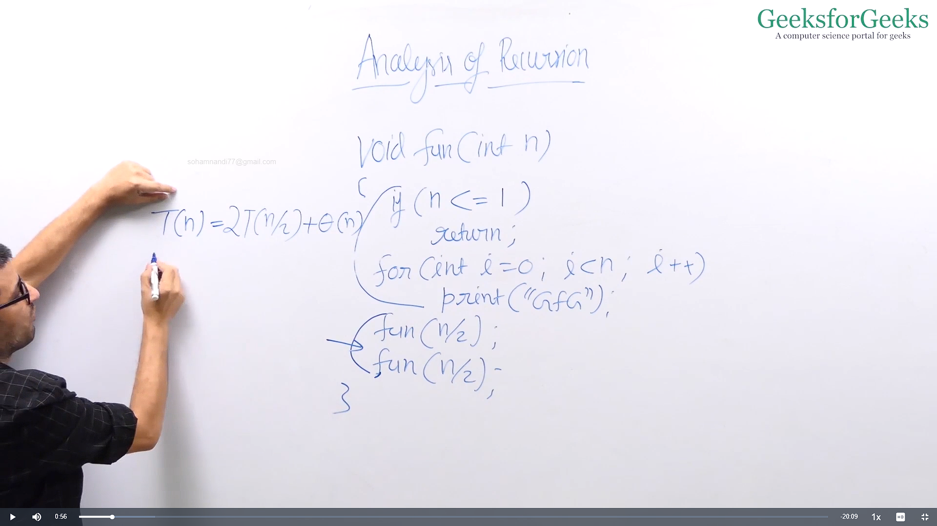
Θ(n)
→ T(n/2)
→ T(n/2)
T(n) = 2T(n/2) + Θ(n)

Slide 3
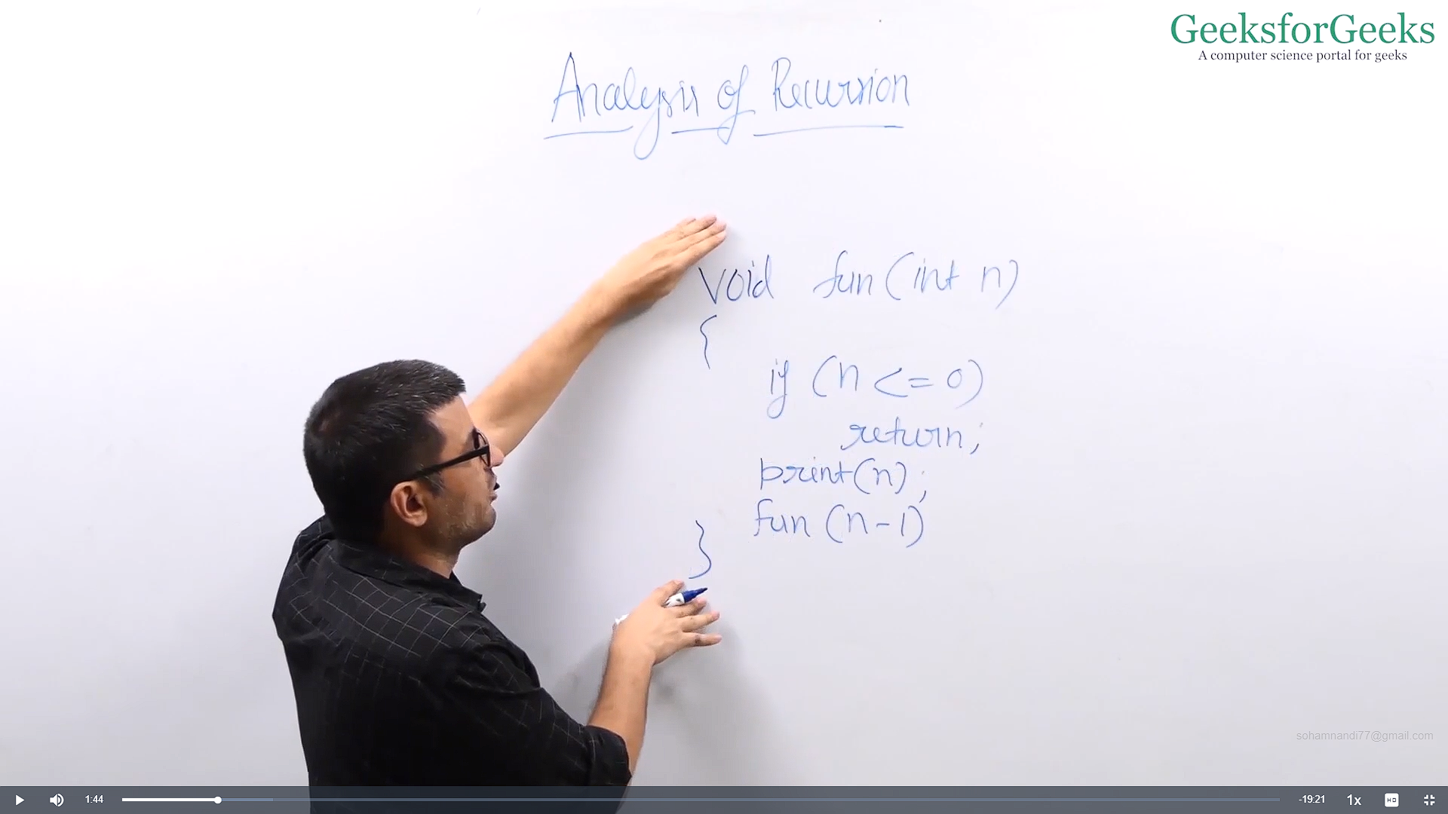
Find the recurrence relations for the function?
Θ(1)
→ T(n-1)
T(n) = T(n-1) + Θ(1)

Slide 4
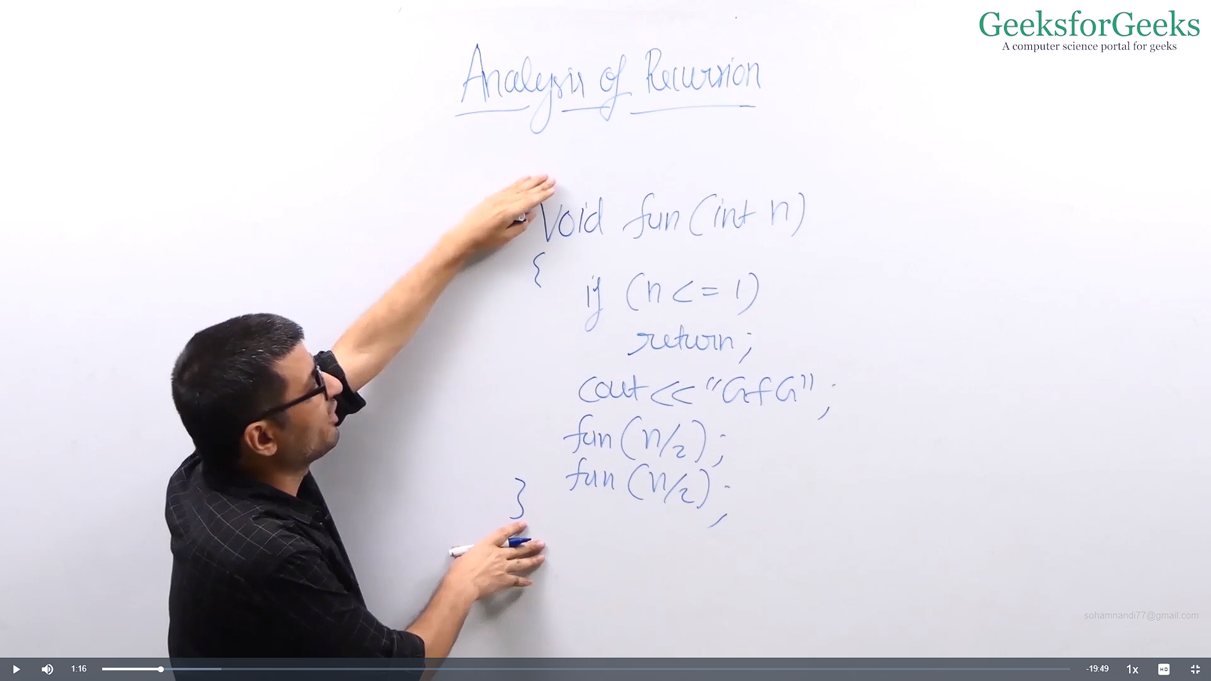
Find the recurrence relations for the function?
T(n) = 2T(n/2) + Θ(1)

Slide 5

Different types of recurrence relations and their solutions
Type 1: Divide and conquer recurrence relations –
Type 2: Linear recurrence relations –
Type 3: Value substitution before solving –
T(n) = 2T(n/2) + cn
T(n) = 2T(n/2) + √n
T(n) = T(n-1)+ T(n-2)+ n for n>0 and T(0) = 1
T(n) = T(√n) + 1

Slide 6
Methods to Solve Recurrence Relations
Substitution Method
Master Method
Type 1: Divide and conquer recurrence relations
Type 2: Linear recurrence relations
Recurrence Tree Method

Slide 7
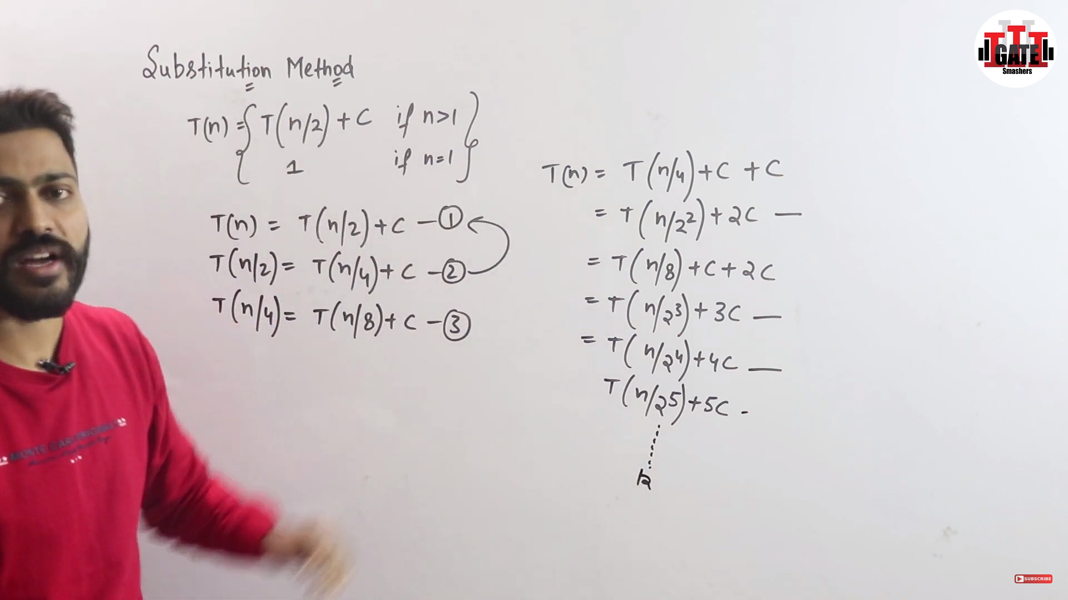
T(n) = T(n/2^k) + kc
For what value, 2^k = n
T(n) = T(n/n) + kc
T(n) = T(1) + kc = 1 +kc
From, 2^k = n,we can write: k = logn
T(n) = 1 + (logn)c
T(n) = Θ(logn)

Slide 8
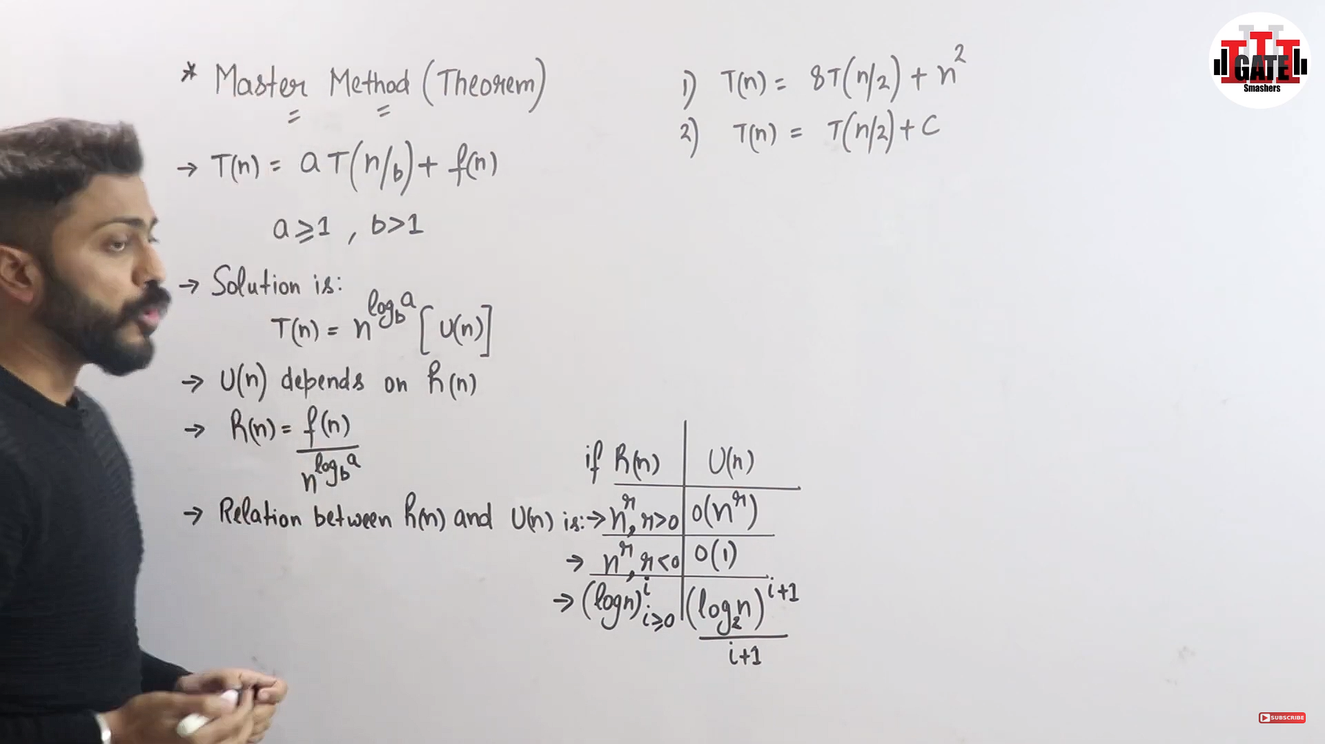

Slide 9
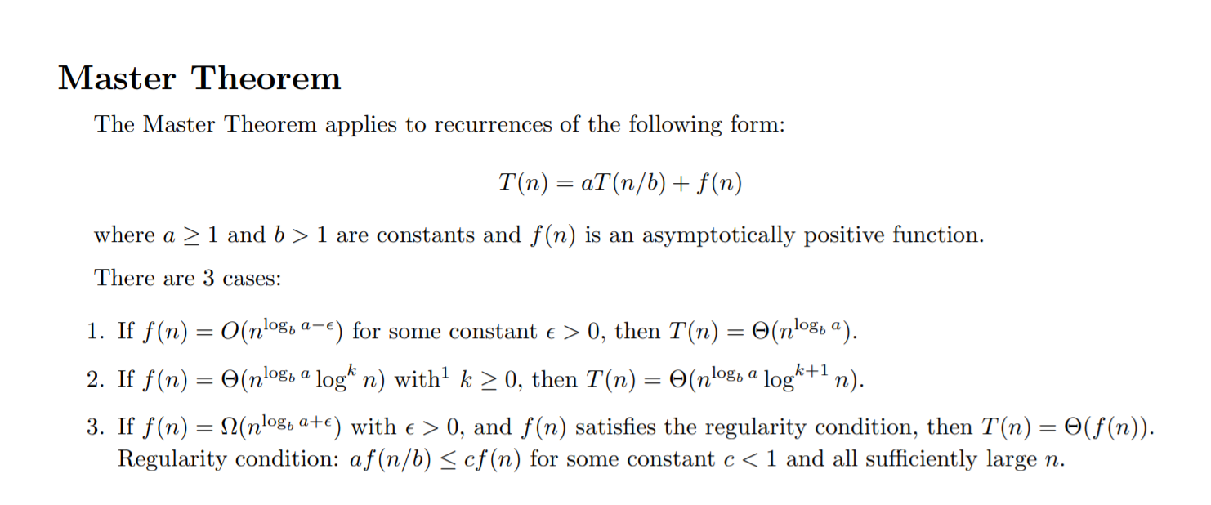

Slide 10
In Very Simple Terms:
First calculate, n^{log}_{b}a , say Y
Then compare it with f(n):
If f(n) < Y then Θ(Y)
if f(n) = Y or Ylog^{k}n then Θ(Ylog^{k+1}n)
Then we came to 3rd case: f(n) > Y
First check regularity condition:
af(n/b) < cf(n) or some constant c < 1 and all sufficiently large n.
Then check weather there is non-polynomial difference between f(n) and Y
Example: f(n) != n/ log n
If it’s 3rd case then directly write answer: Θ(f(n))

Slide 11
Let’s Do some Questions?

Slide 12
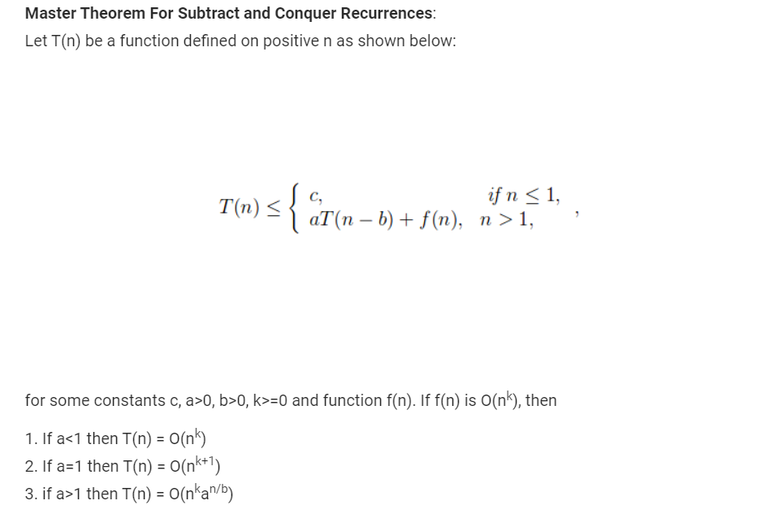
Master Method: Type 2

Slide 13
T(n) = T(n-1) + T(n-2)
For Worst Case, Let T(n-1) ≈ T(n-2)
→T(n) = 2T(n-1) + cn^0
→where,f(n) = O(1)
∴ k=0, a=2, b=1;
→T(n) = O((n^0)*2^(n/1))
→= O(2^n)
For Best Case, Let T(n-2) ≈ T(n-1)
→T(n) = 2T(n-2) + cn^0
→where,f(n) = O(1)
∴ k=0, a=2, b=2;
→T(n) = O(n⁰2^{n/2}) = O(2^{n/2})

Slide 14
T(n) = 3T(n-1) + 0, n>0 = c, n<=0
Sol:a=3, b=1, f(n)=0 so k=0;
Since a>0, T(n) = O(nkan/b)
T(n)= O((n^0)*3^(n/1))
T(n)= 3^n

Slide 15
T(n) = T(n-1) + n^2 - n), if n>=2 = 1, if n=1
Sol:a=1, b=1, f(n)=n(n-1) so k=2;
Since a=1, T(n) = O(nk+1)
T(n)= O(n^(2+1))
T(n)= O(n^3)

Slide 16
T(n) = 2T(n-1) + (– 1), if n>0 = 1, if n<=0
This recurrence can't be solved using above method since function is not of form T(n) = aT(n-b) + f(n)
f(n) > 0 should be – then only question will be solved

Slide 17
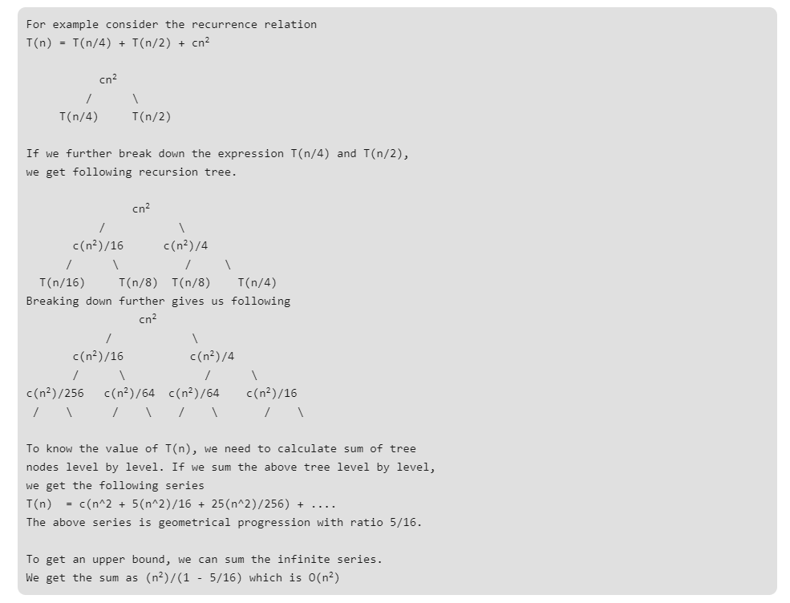
Recurrence Tree Method:

Slide 18
Homework question?
T(n) = nT(n-1)
T(1)= 1
Ans -

